Slide 1
XRD
By
Aparna Patil Kose
Lecturer
Dept of Bioinformatics

Slide 2
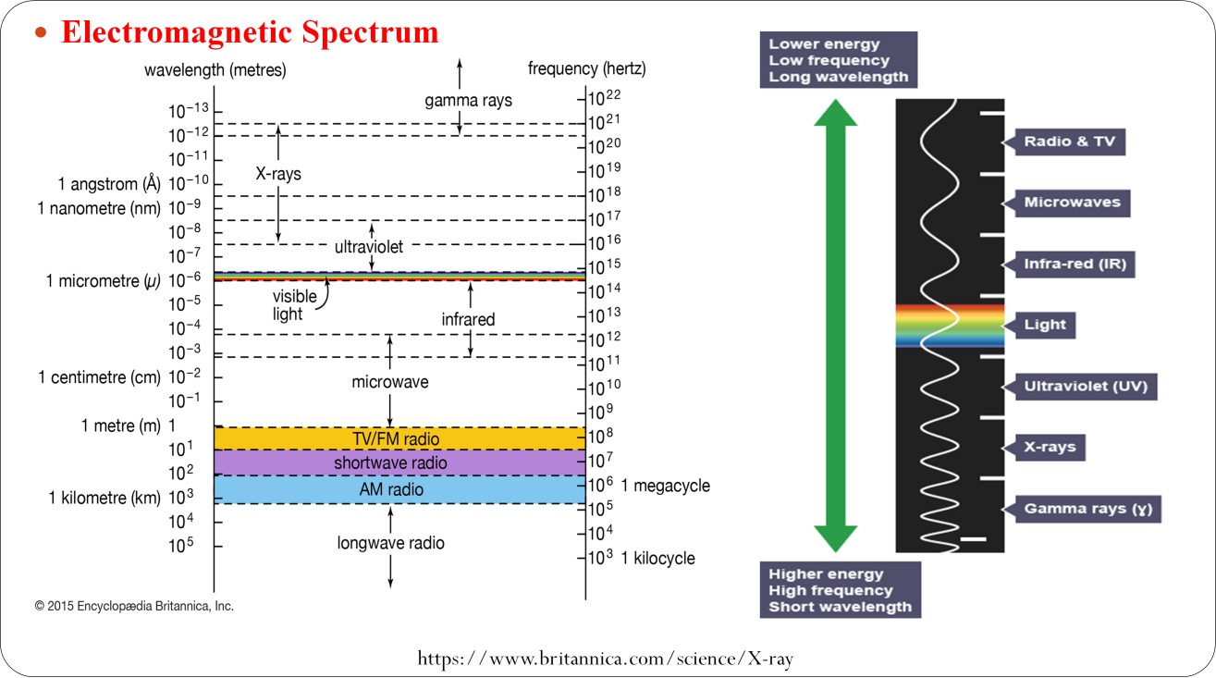

Slide 3
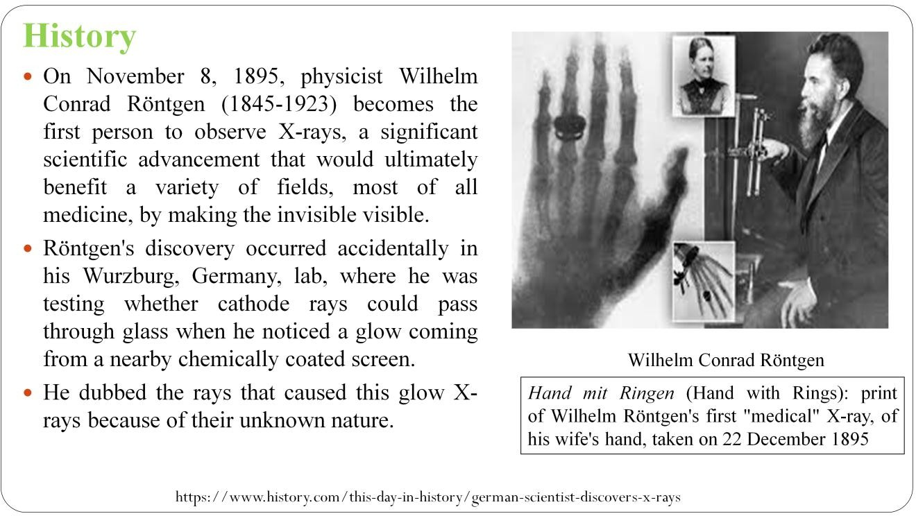

Slide 4
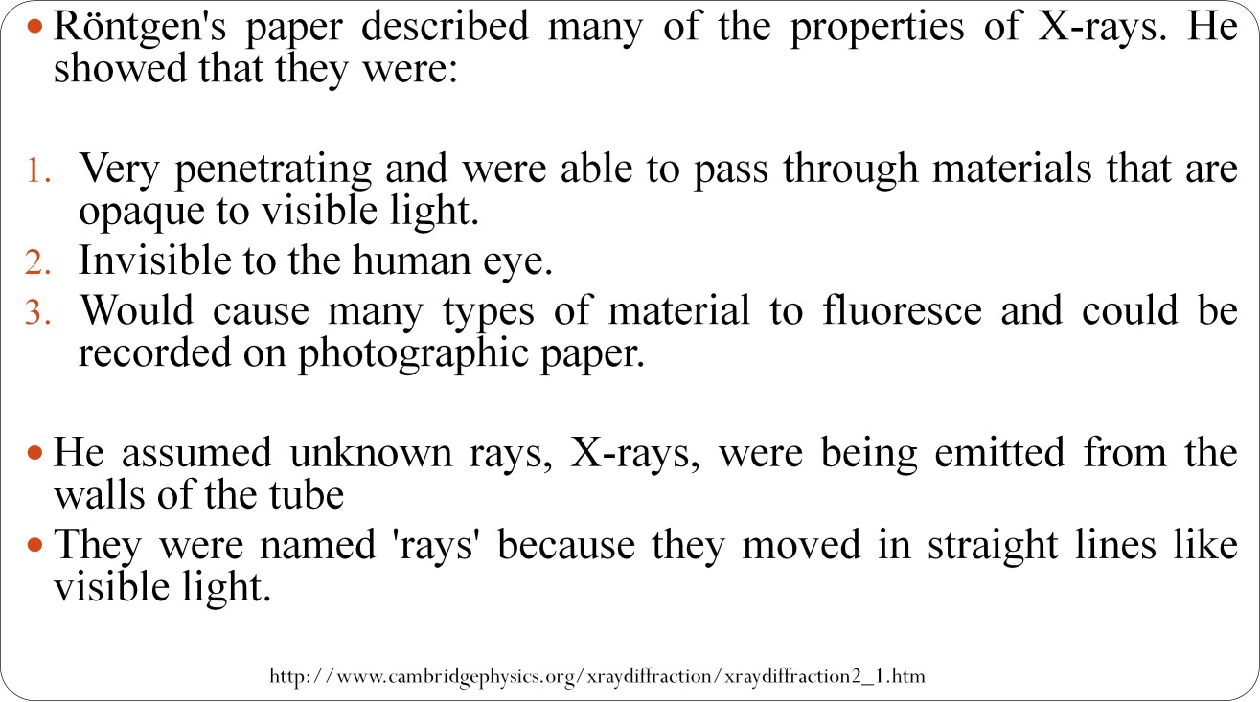

Slide 5
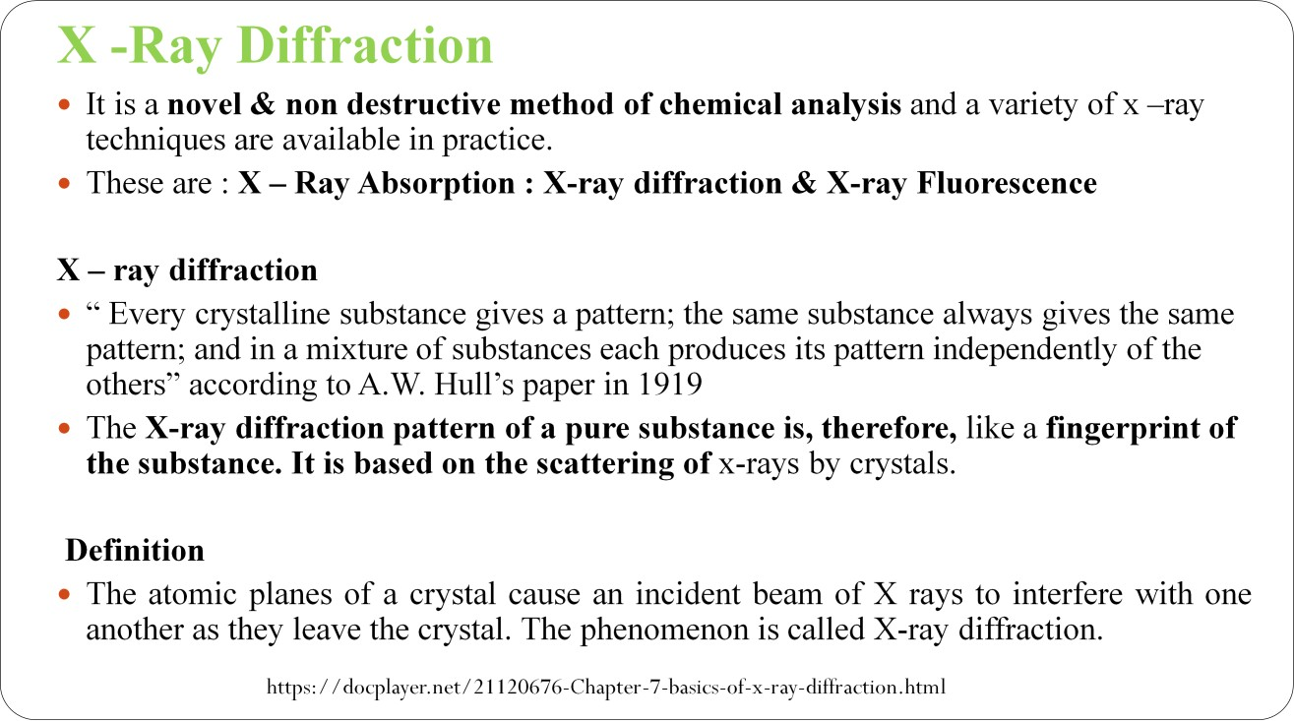

Slide 6
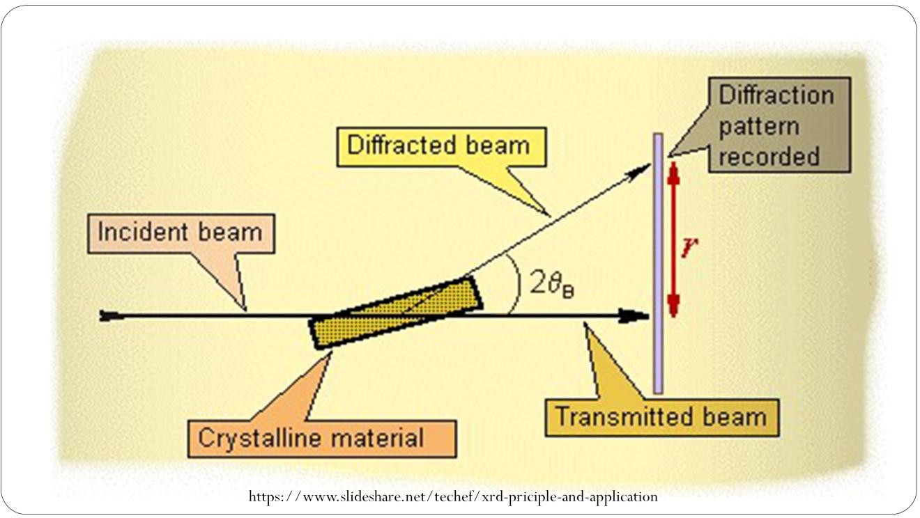

Slide 7
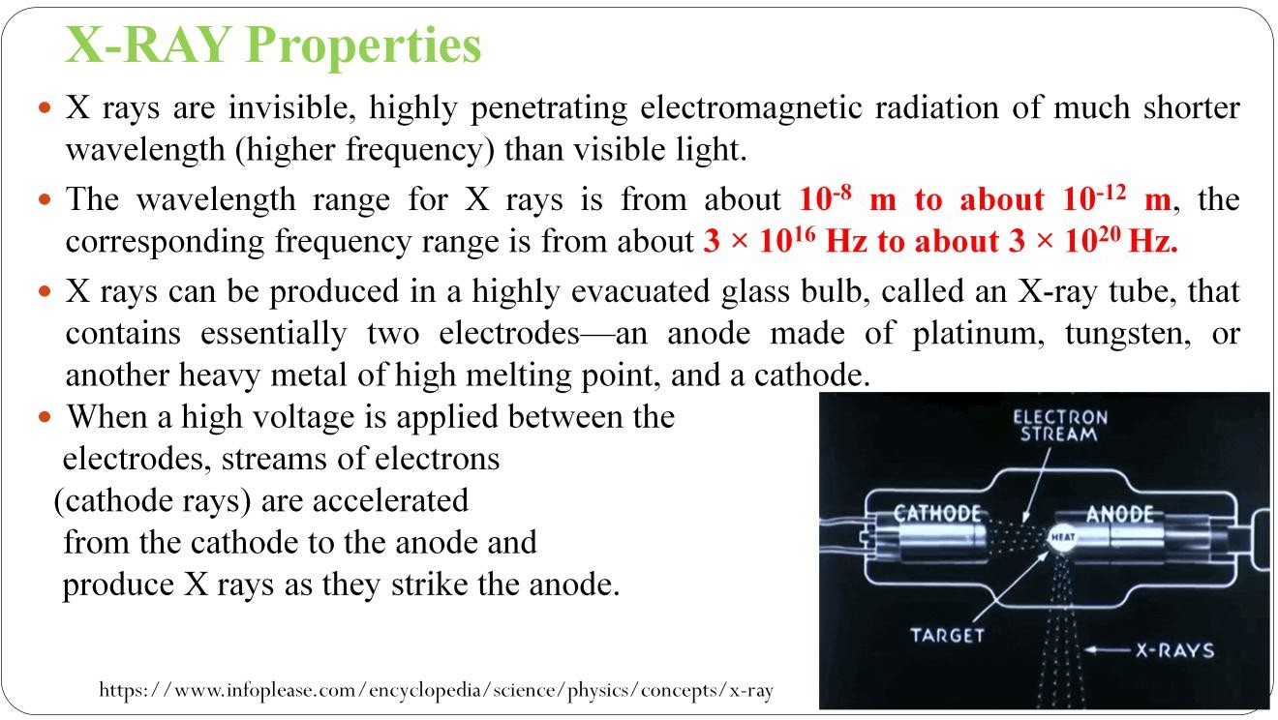

Slide 8


Slide 9
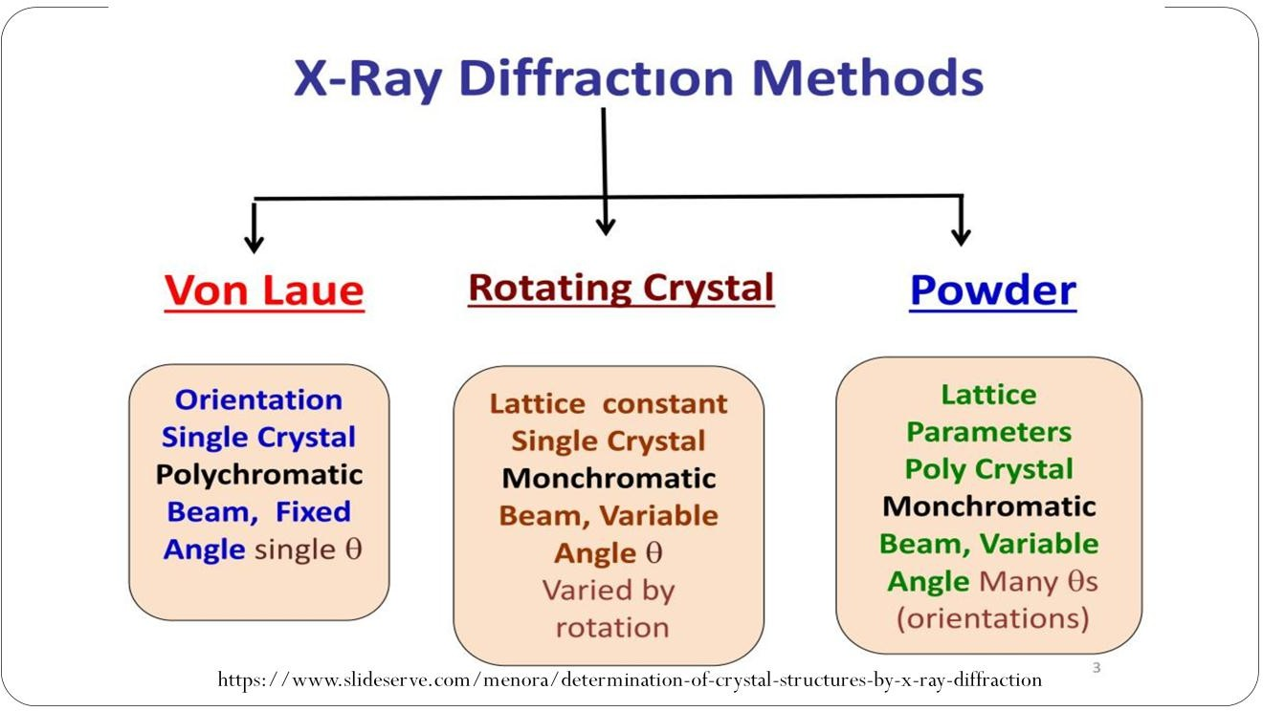

Slide 10
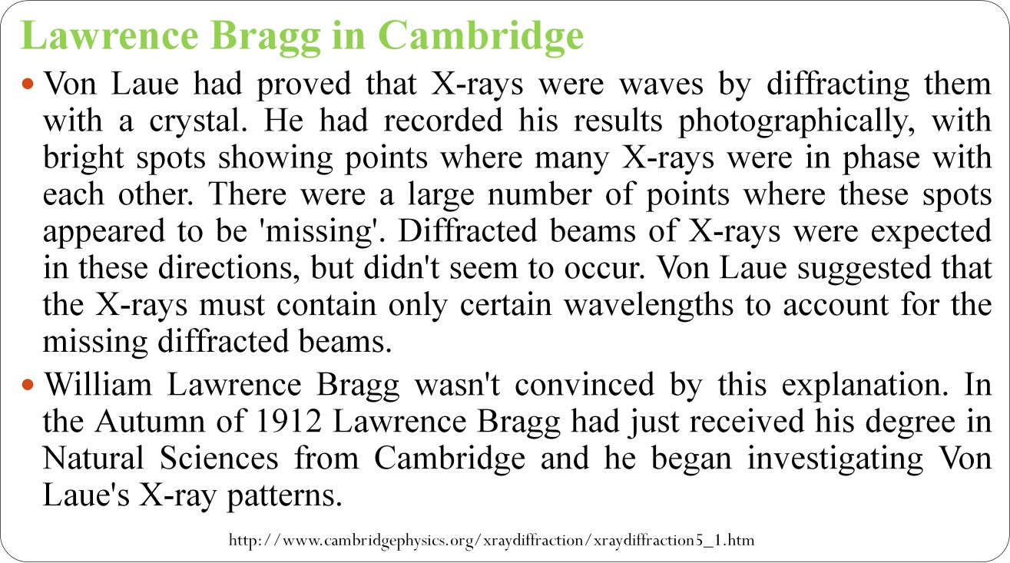

Slide 11
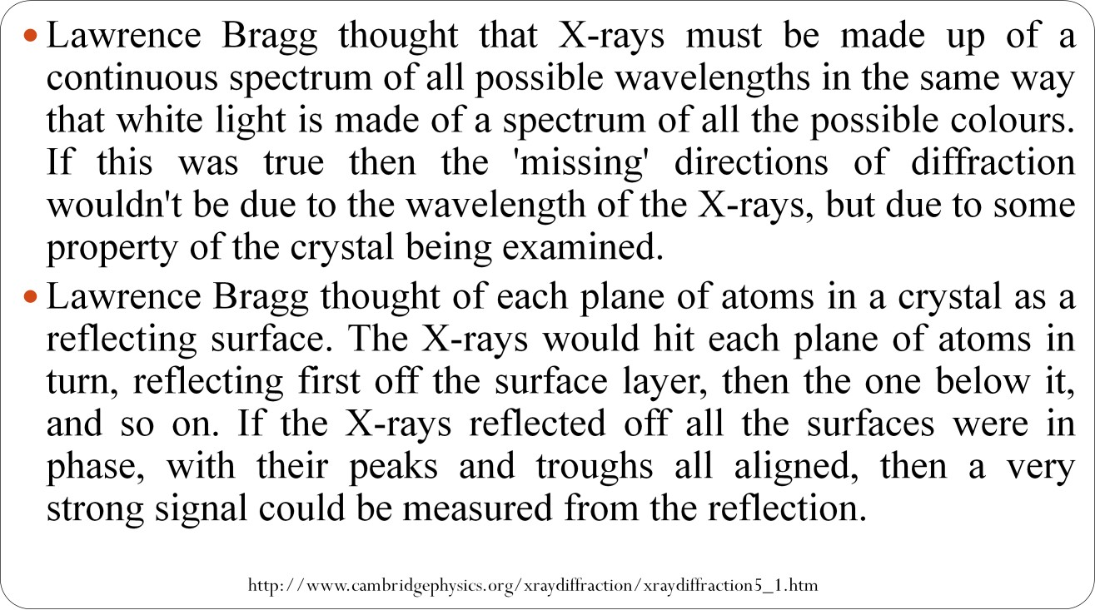

Slide 12
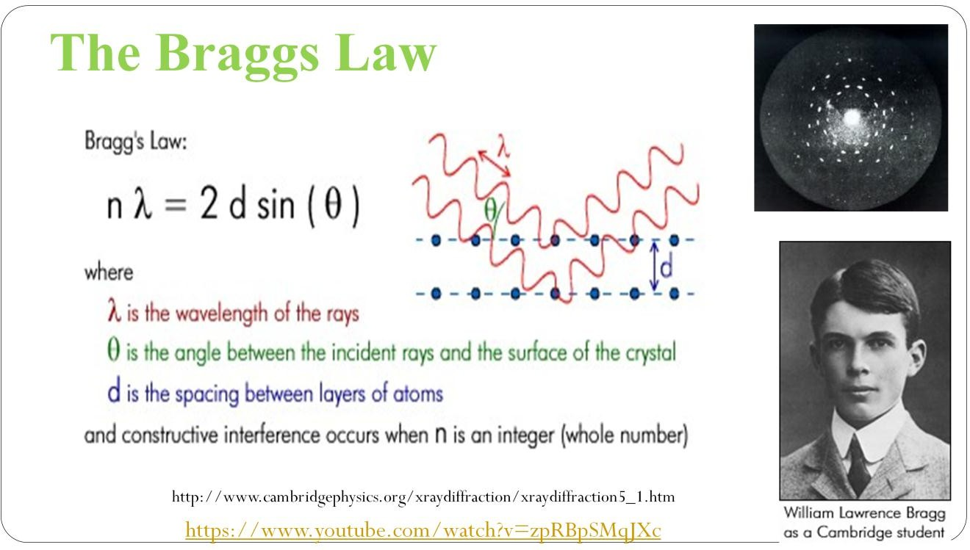

Slide 13
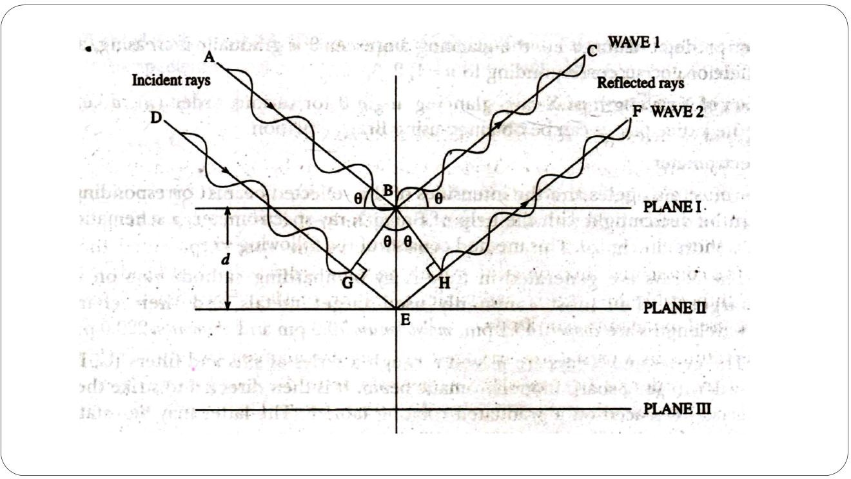

Slide 14
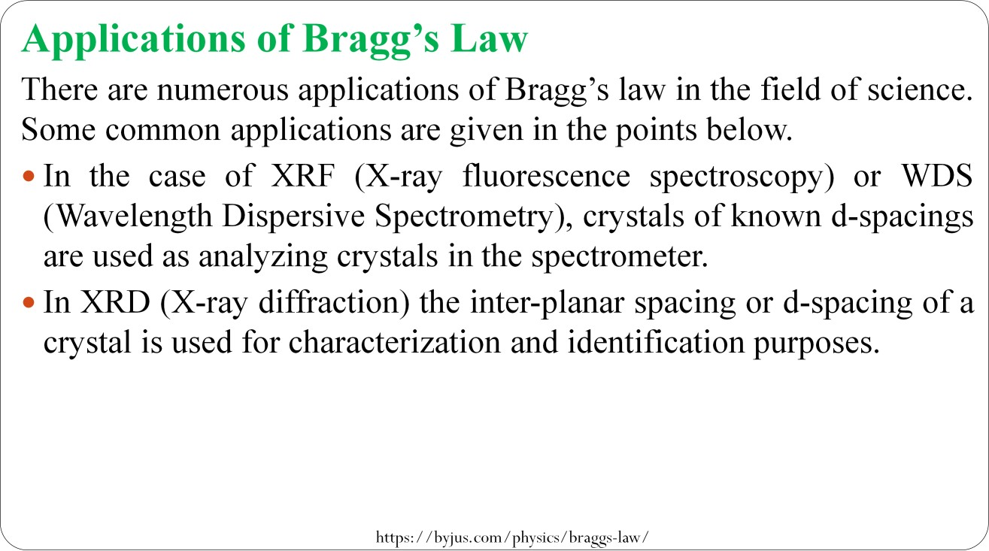

Slide 15
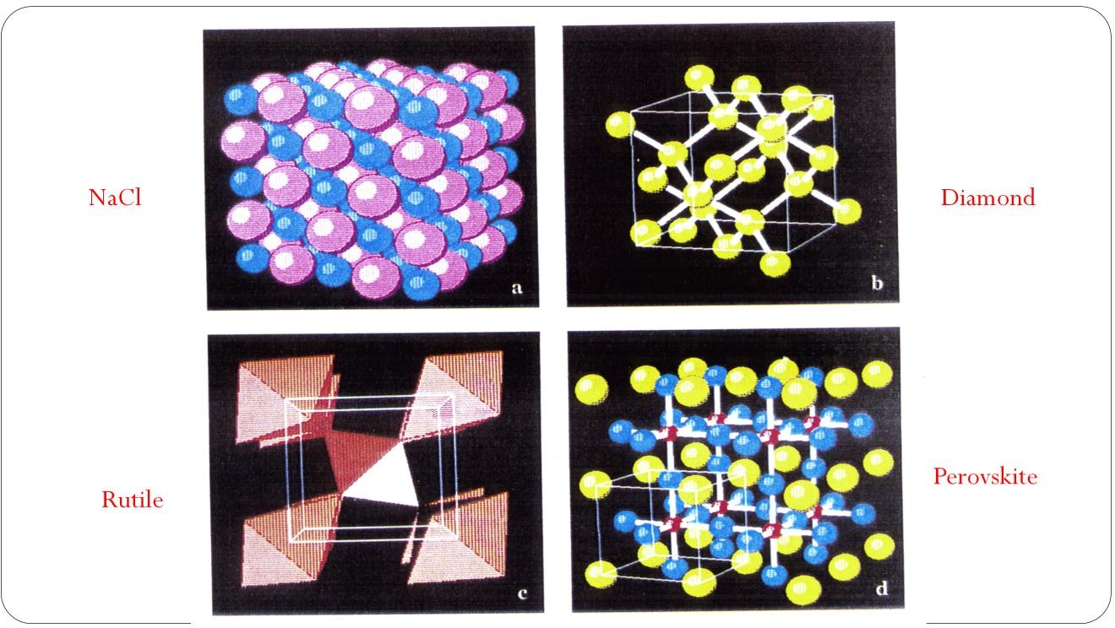

Slide 16
Principle of X-Ray Spectroscopy
XRF works on methods involving interactions between electron beams and x-rays with samples.
It is made possible by the behavior of atoms when they interact with radiation.
When materials are excited with high-energy, short wavelength radiation (e.g., X-rays), they can become ionized.
When an electron from the inner shell of an atom is excited by the energy of a photon, it moves to a higher energy level.
When it returns to the low energy level, the energy which it previously gained by the excitation is emitted as a photon which has a wavelength that is characteristic for the element (there could be several characteristic wavelengths per element).
Thus atomic X-rays emitted during electronic transitions to the inner shell states in atoms of modest atomic number.
These X-rays since have characteristic energies related to the atomic number, and each element therefore has a characteristic X-ray spectrum which can be used to identify the element.

Slide 17
Working of X-Ray Spectroscopy
An XRF spectrometer works because if a sample is illuminated by an intense X-ray beam, known as the incident beam, some of the energy is scattered, but some is also absorbed within the sample in a manner that depends on its chemistry.
When x-ray hits sample, the sample emits x-rays along a spectrum of wavelengths characteristic of the type of atoms present.
If a sample has many elements present, the use of a Wavelength Dispersive Spectrometer allows the separation of a complex emitted X-ray spectrum into characteristic wavelengths for each element present.
Various types of detectors used to measure intensity of emitted radiation.
The intensity of the energy measured by these detectors is proportional to the abundance of the element in the sample.
The exact value for each element is derived from standards from prior analyses from other techniques.

Slide 18
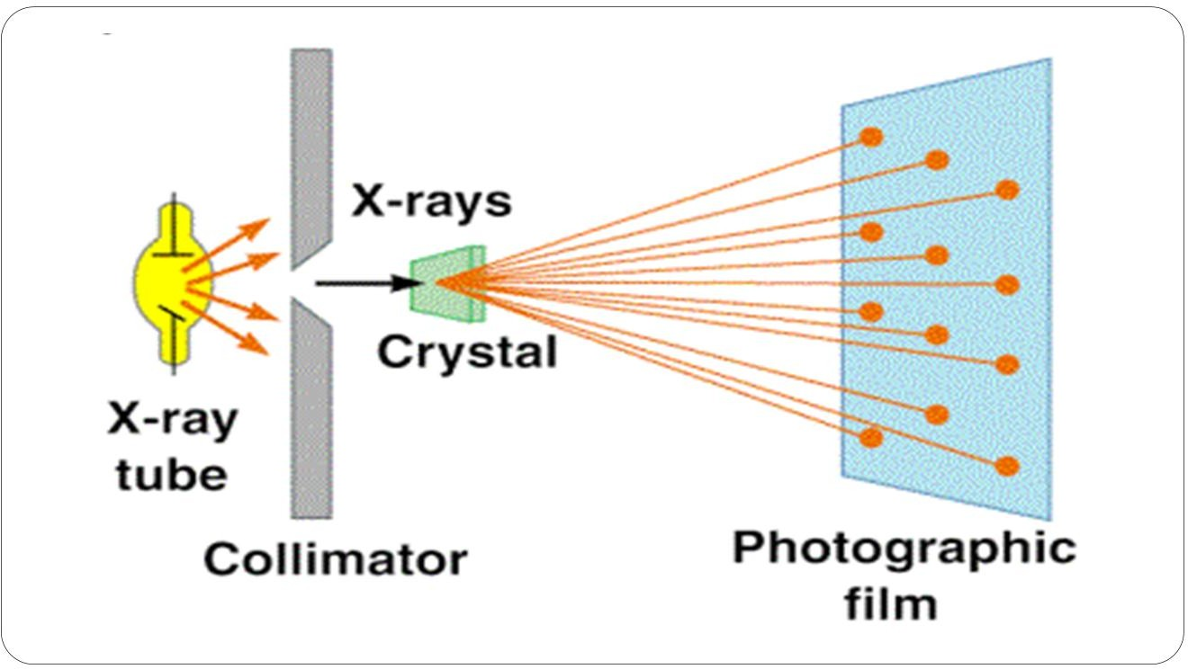
Instrumentation of X-Ray Spectroscopy
Components for X-ray spectroscopy are:
X-ray generating equipment (X-ray tube)
Collimator
Monochromators
Detectors

Slide 19
A. X-ray generating equipment (X-ray tube)
X-rays can be generated by an X-ray tube.
X-rays tube is a vacuum tube that uses a high voltage to accelerate the electrons released by a hot cathode to a high velocity.
The high velocity electrons collide with a metal target, the anode, creating the X-rays.
B. Collimators
A collimator is a device that narrows a beam of particles or waves.
Narrow mean to cause the directions of motion to become more aligned in a specific direction (i.e., collimated or parallel).
Collimation is achieved by using a series of closely spaced ,parallel metal plates or by a bundle of tubes ,0.5 or less in diameter.

Slide 20
C. Monochromator
Monochromator crystals partially polarize an unpolarized X-ray beam.
The main goal of a monochromator is to separate and transmit a narrow portion of the optical signal chosen from a wider range of wavelengths available at the input.
Types of Monochromator
Metallic Filter Type
Diffraction grating type

Slide 21
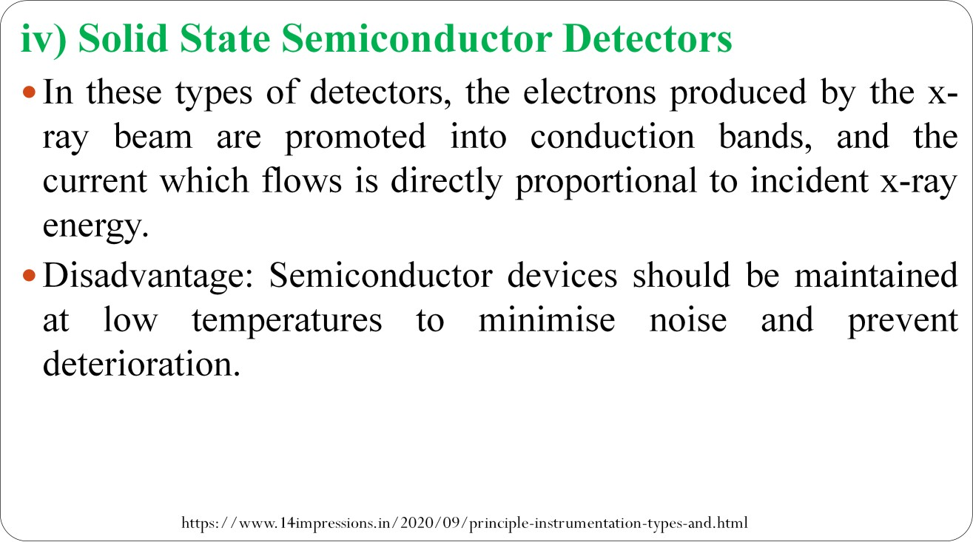
D. X-ray Detectors
The most commonly employed detectors include:
Solid State Detectors
Scintillation Detectors

Slide 22
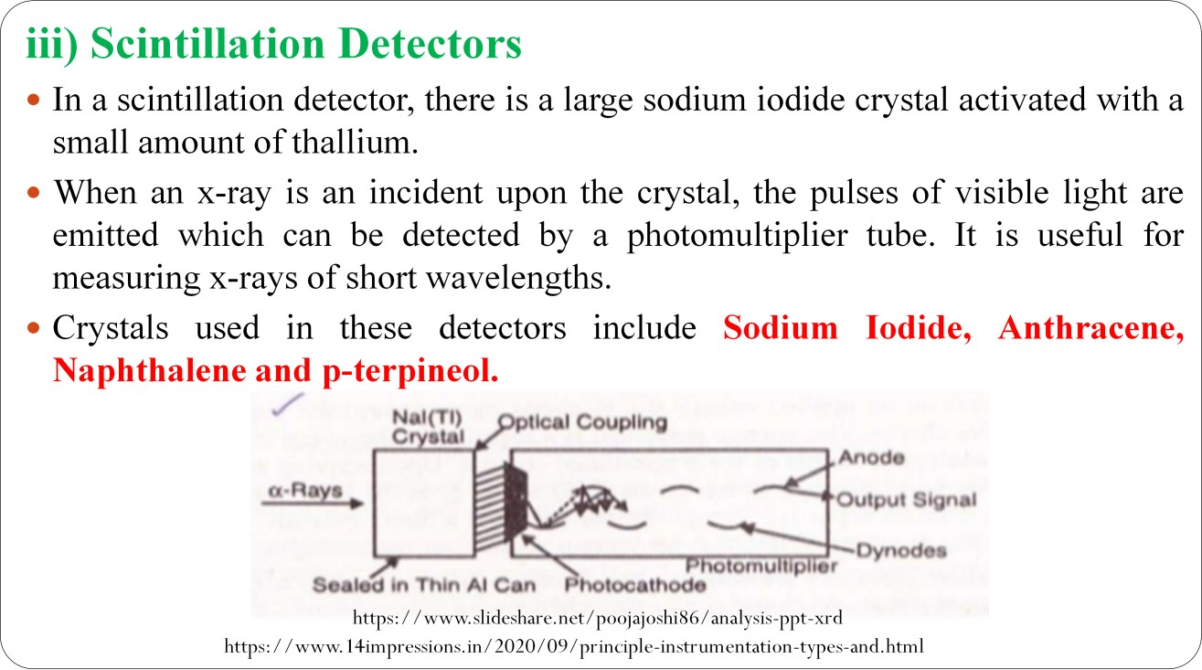

Slide 23
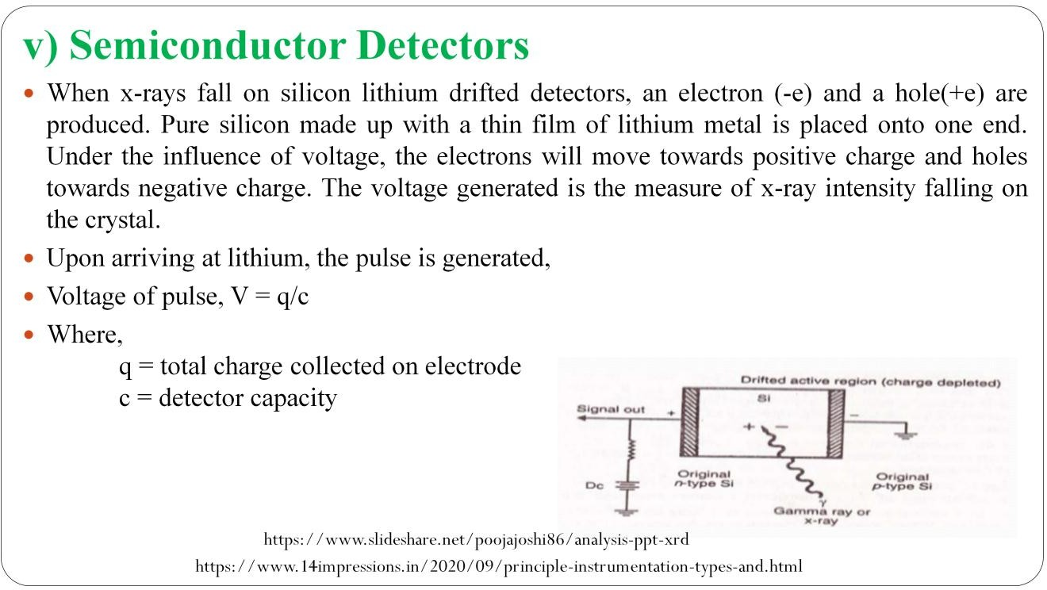

Slide 24
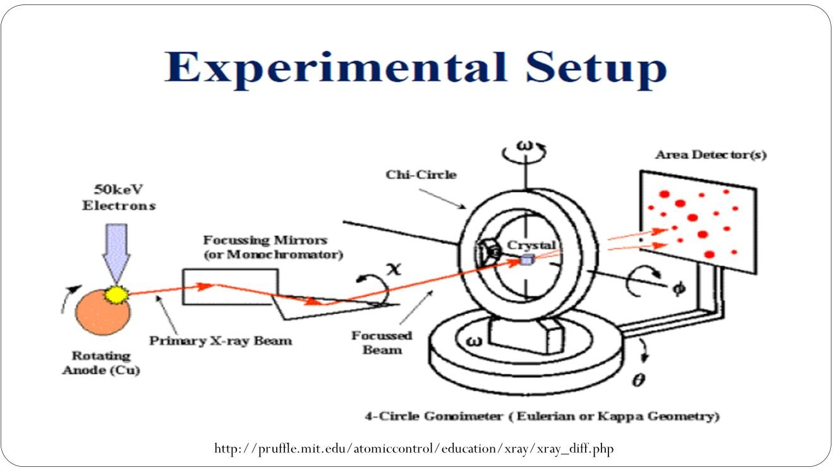

Slide 25
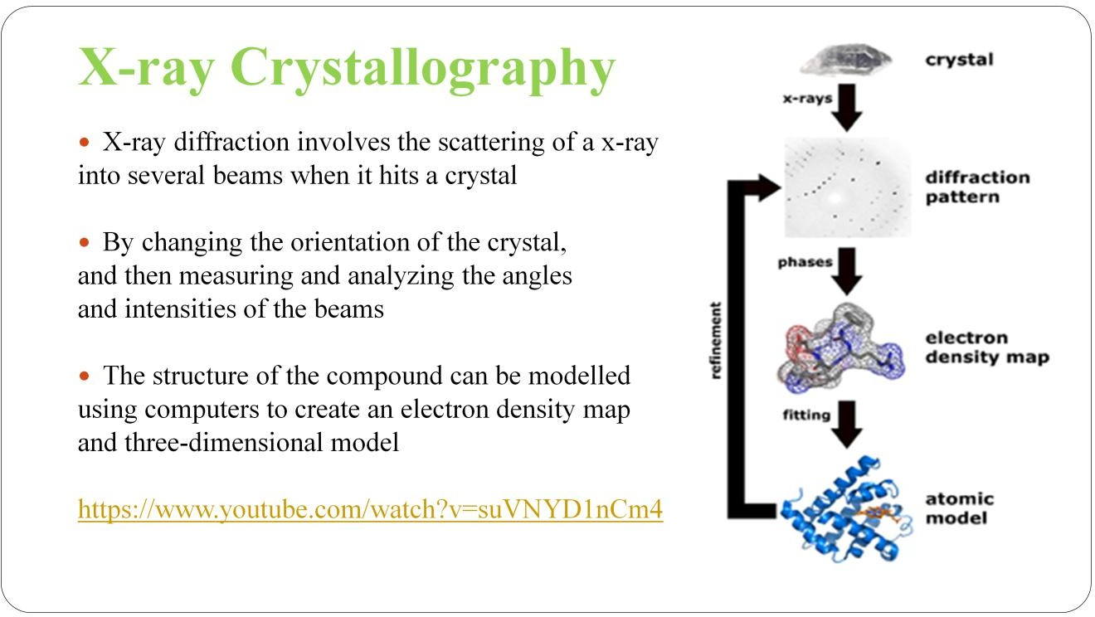

Slide 26
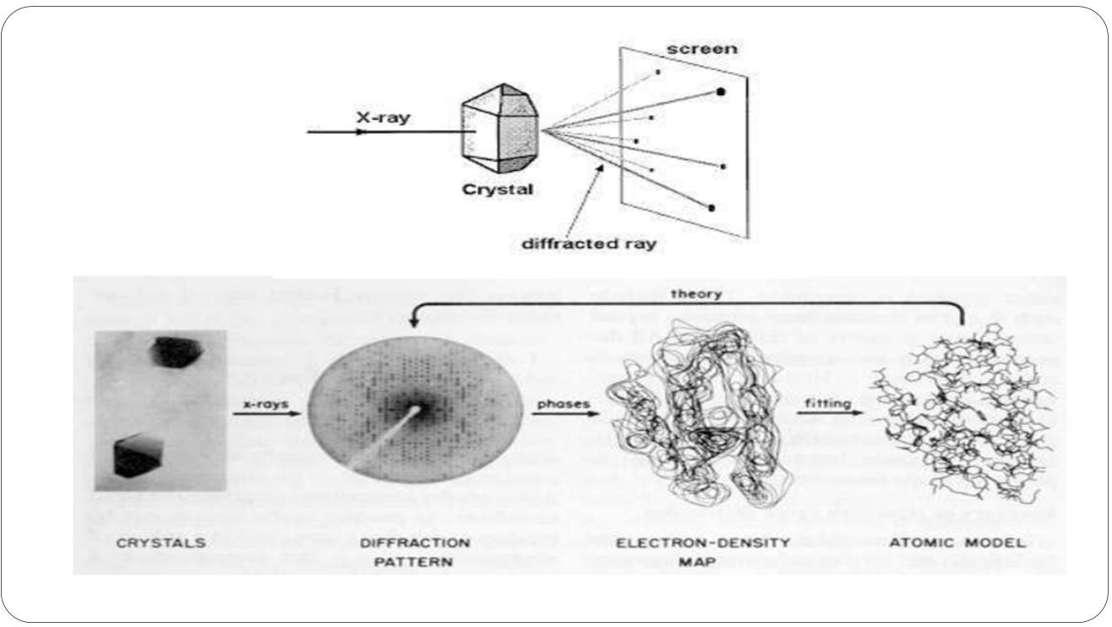

Slide 27
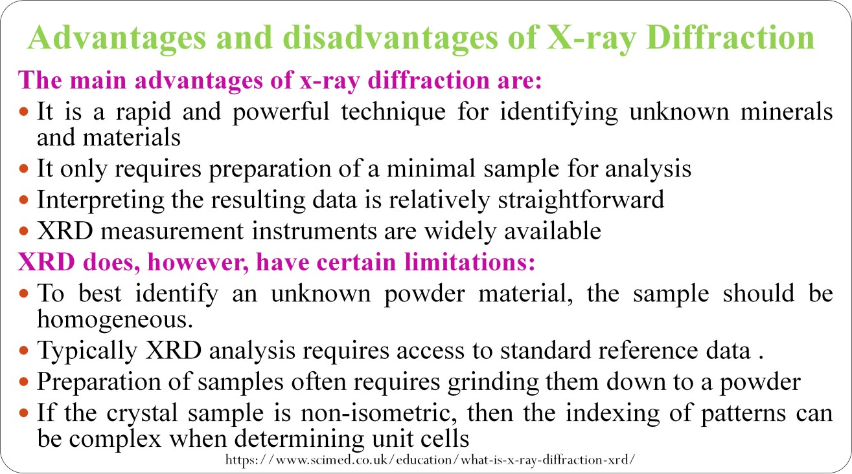

Slide 28
Limitations of X-Ray Spectroscopy
The technique requires the availability of a compound as a single crystal.
Most chemists find this process very tedious, time consuming and it requires a skillful hand

Slide 29
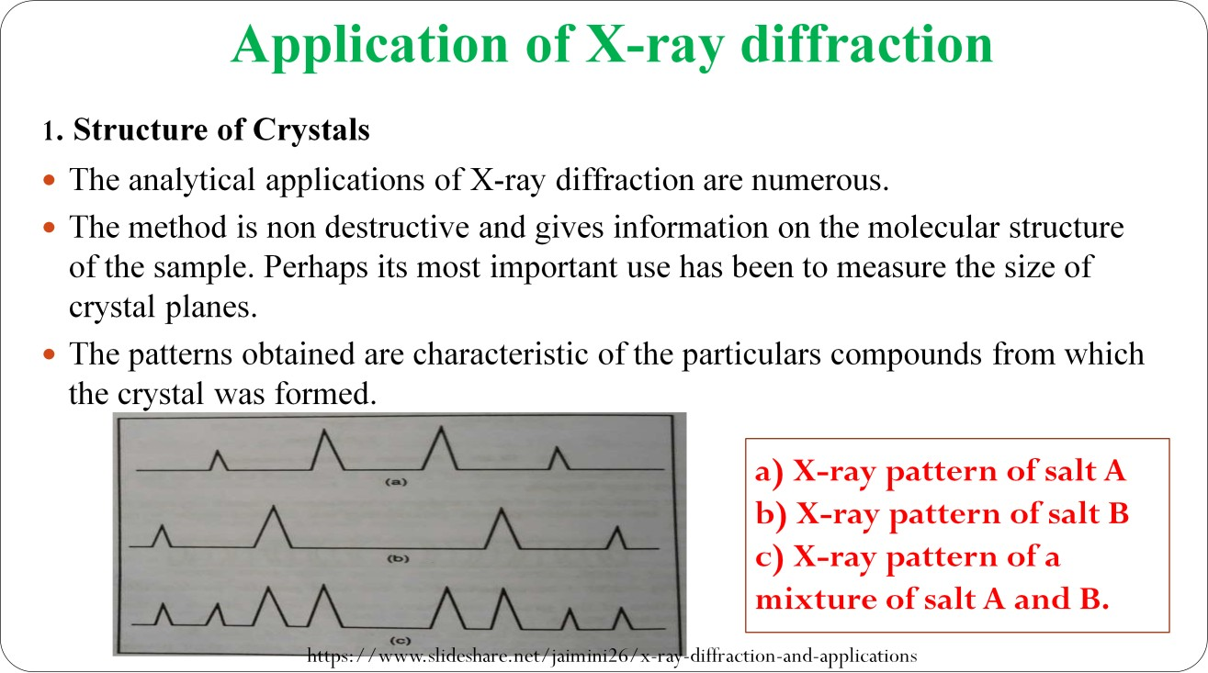

Slide 30
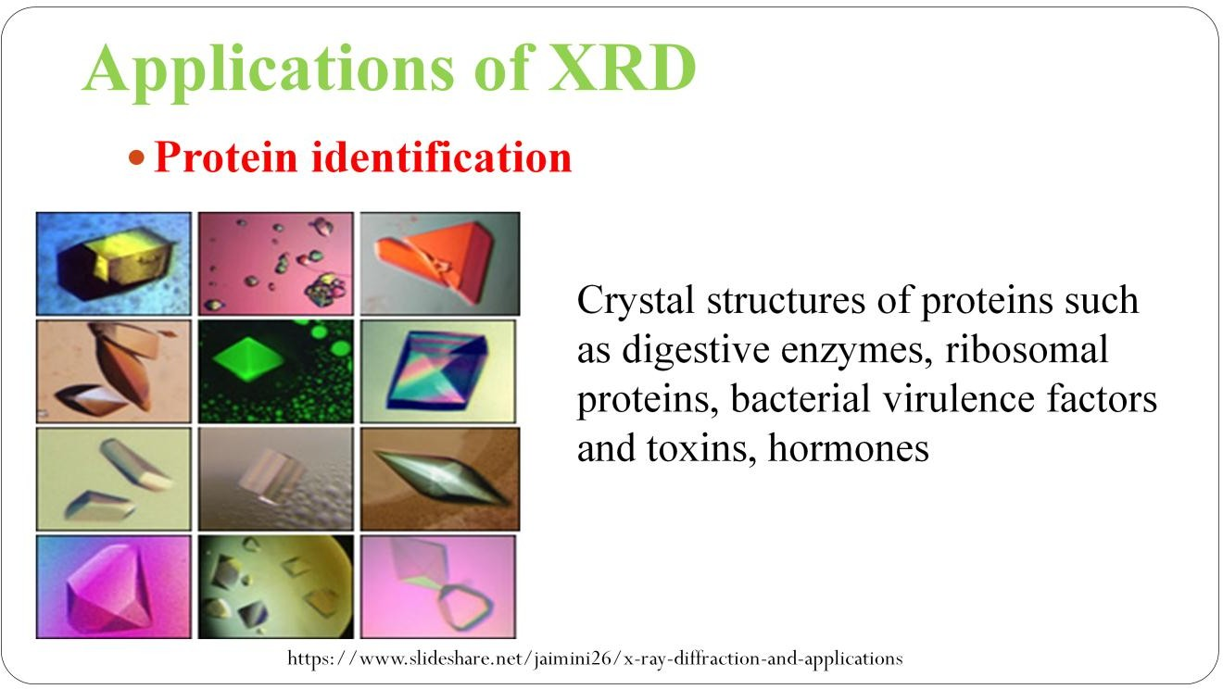

Slide 31
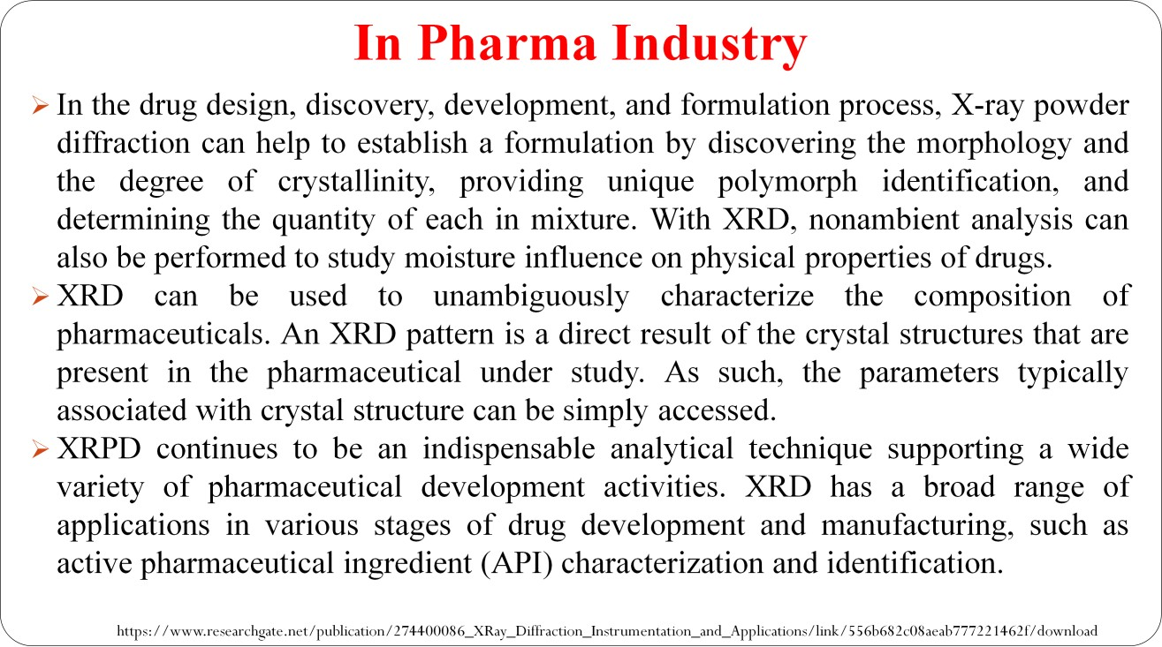

Slide 32
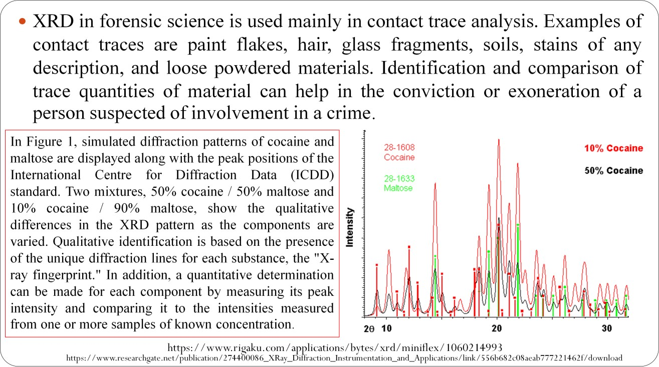
Forensic Science

Slide 33


Slide 34


Slide 35


Slide 36


